Slide 1

New York Citywide Payroll
Data Visualization and Analysis
CSYE 7250 Big Data Architecture and Governance
Instructor: Prof. Kambiz Heydari

Slide 2
Group 9 - Team Members
Akshaya Suresh - DB Admin
Luvesh Tekchandani - BI Developer
Swagath Varanchi Chandregowda - Data Steward
Neelambari Verma - Project Manager
Ranga Chari Vinjamuri - Data Analyst
Maintaining Data Dictionary, monitoring performance to maintain project standards and needs.
Data Preprocessing and Loading data, Aggregating Data and giving it further to Analyst
For Utilizing project’s data governance ensuring fitness of the data elements-both content and metadata
Deliver all the components of the project with planning and execution of the project
Highlights the analytical nature and visualizing the data

Slide 3
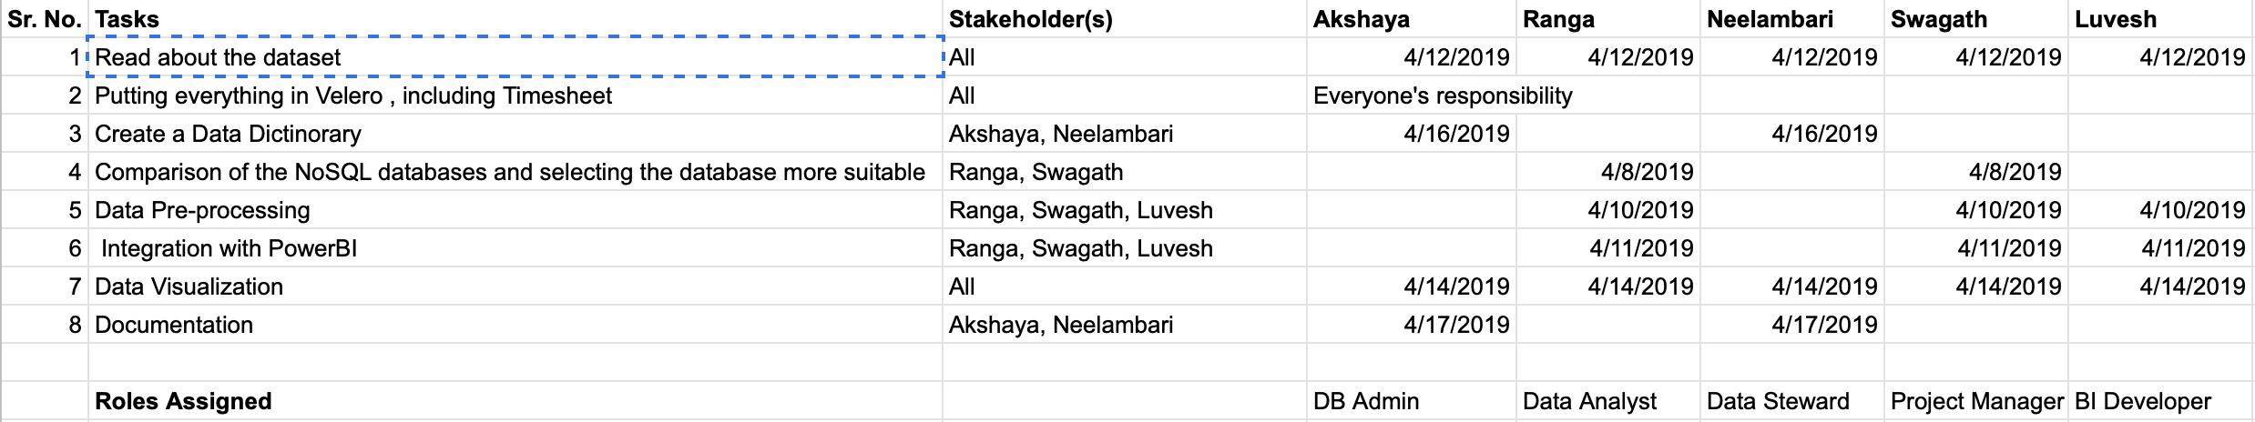
Progressive planning

Slide 4
Project Plan
Reading about the Data from Kaggle
Create a Data Dictionary
Comparison of NoSQL database and selecting more suitable one
Data Pre-processing, Integration with PowerBI
Data Visualization and Documentation

Slide 5
Milestone
8th April '19
Discussing about the Project implementation Flow
10th April '19
Tried implementing MarkLogic and Casandries
Selected MongoDB as our NoSQL Database and started with implementation
12th April '19
15th April '19
Loading Data into PowerBI and Visualization
Analysis and Documentation
18th April '19
Presentation Ready

Slide 6
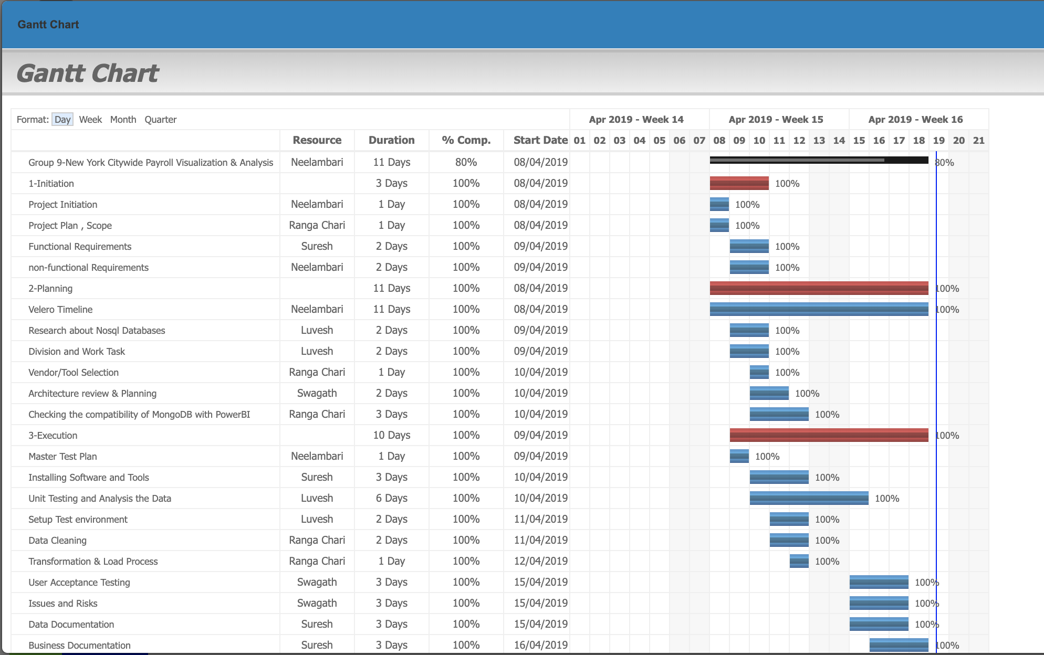
Gantt Chart

Slide 7
Dataset
About: Citywide payroll data for New York City for the 2014, 2015, 2016, and 2017 fiscal years.
Content: This dataset provides columns for fiscal year, employee name, the city department they work for, their job title, and various fields describing their compensation. The most important of these fields is "Regular Gross Pay", which provides that employee's total compensation.
Context: This dataset contains the salary, pay rate, and total compensation of every New York City employee. In this dataset this information is provided for the 2014, 2015, 2016, and 2017 fiscal years, and provides a transparent lens into who gets paid how much and for what.
That means that this dataset contains, in its sum, compensation information for all City of New York employees for the period July 1, 2014 to June 30, 2017.

Slide 8
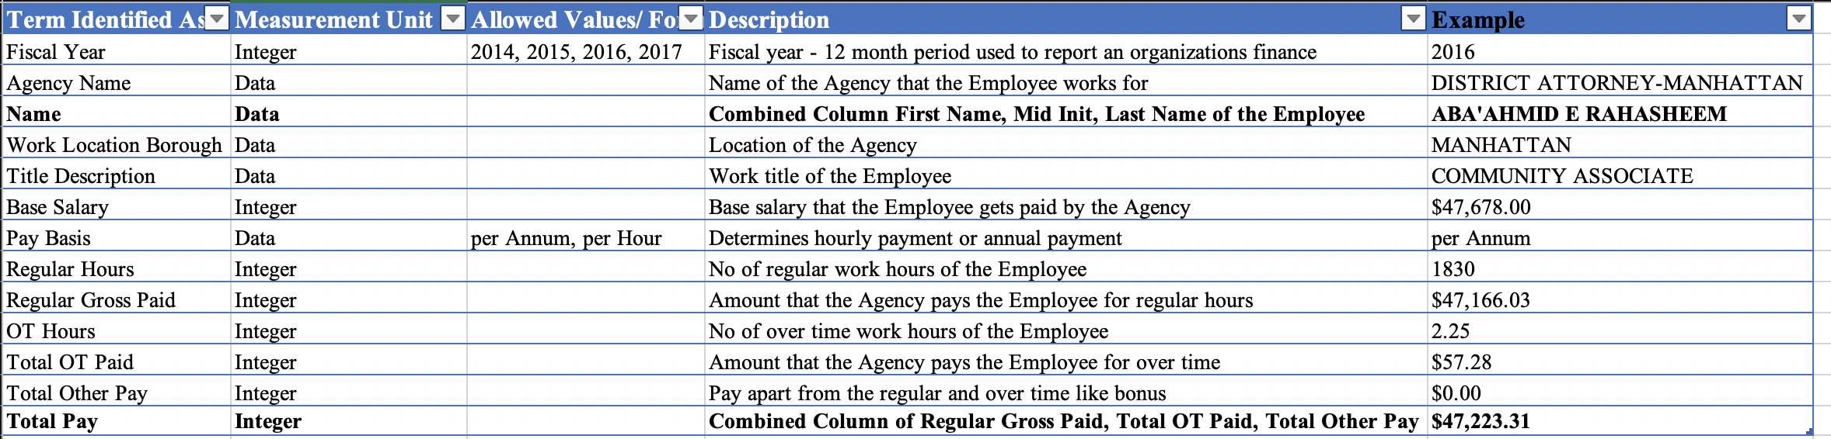
Business Terms
Data Dictionary for the New York Citywide Payroll

Slide 9
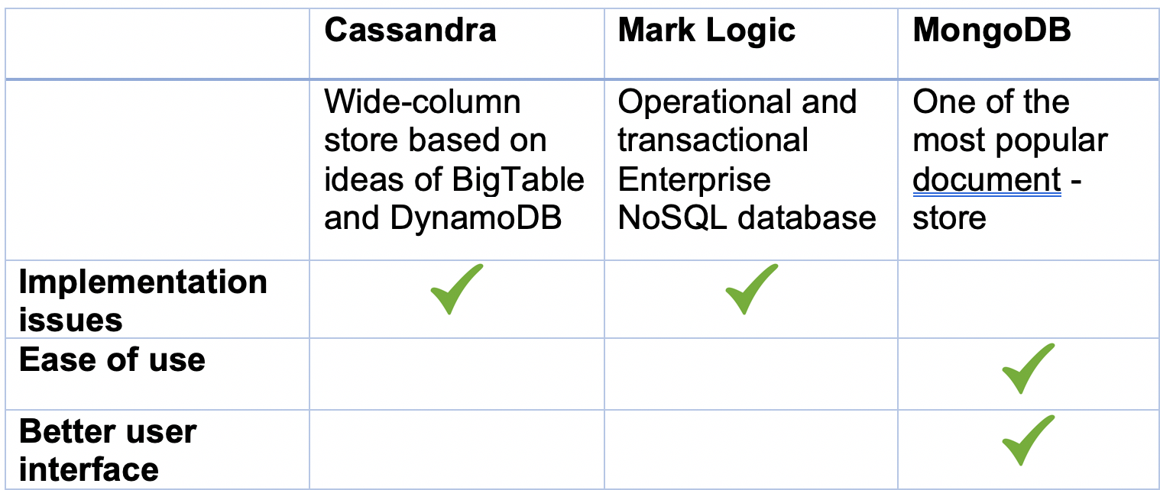
Comparison of NoSQL Databases

Slide 10


Tools
PowerBI- Power BI is a business analytics service by Microsoft. It aims to provide interactive visualizations and business intelligence capabilities with an interface simple enough for end users to create their own reports and dashboards.
MongoDB Atlas- MongoDB is a cross-platform document-oriented database program. Classified as a NoSQL database program, MongoDB uses JSON-like documents with schemata.
MongoDB Atlas is a fully automated cloud service that offers Database Solutions

Slide 11
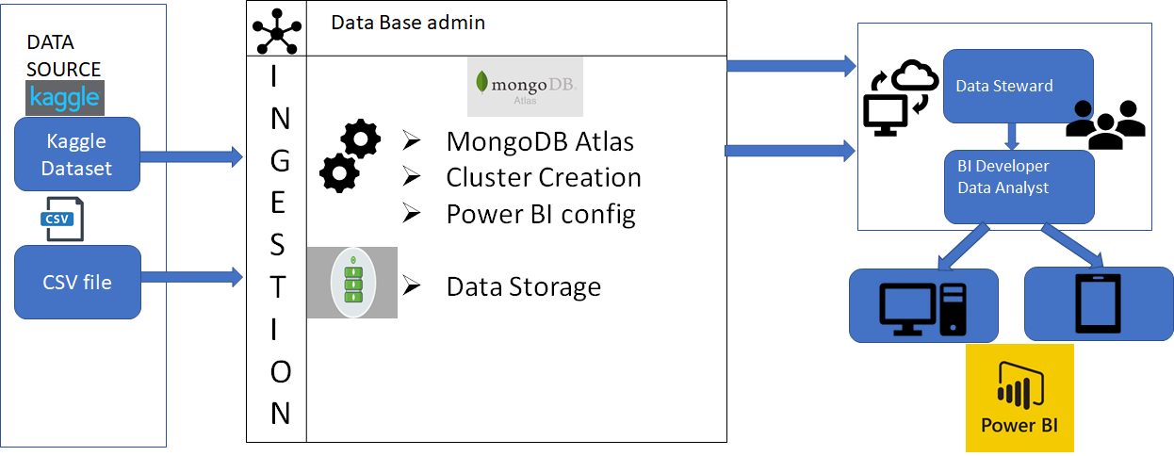
Vision diagram

Slide 12
Data Pre-processing
Removed negative (-ve) values from the Salary columns
Changed the data types - i.e. String to Data, String to integer
Added columns - Combined “First Name”, “Mid Init”, “Last Name” to column “Name”
“Regular Gross Paid”, “Total OT Paid”, “Total Other Pay” - “Total Pay” and then we created a hierarchy for the same.
Added key-value pair for New York map

Slide 13
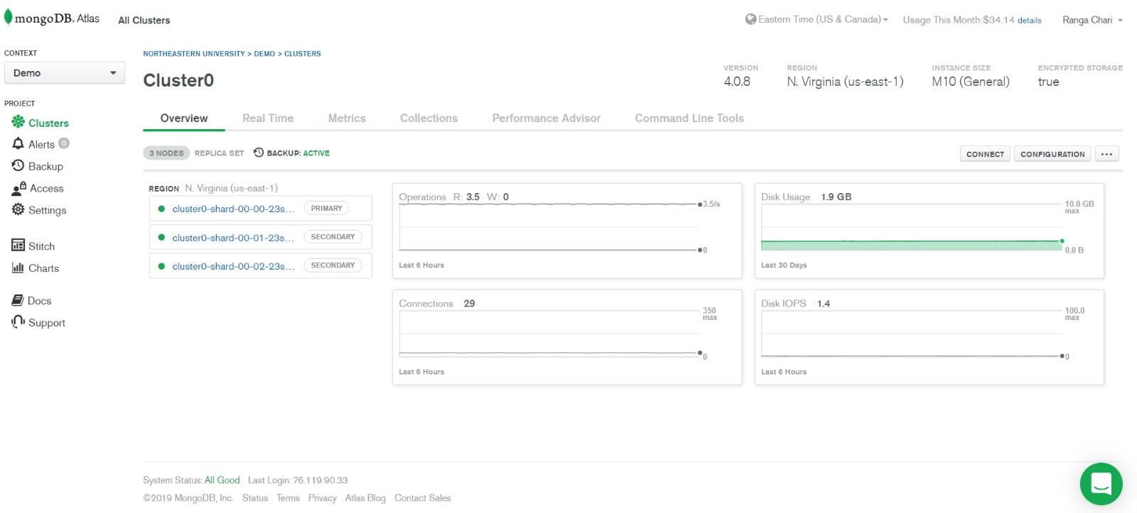
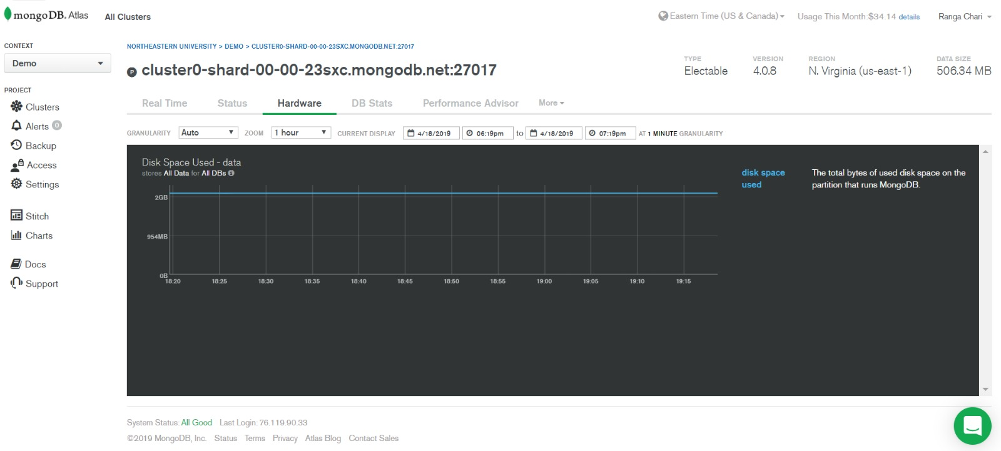
Clusters in MongoDB Atlas
This showcases the memory allocation and usages of about 1.9 GB.

Slide 14
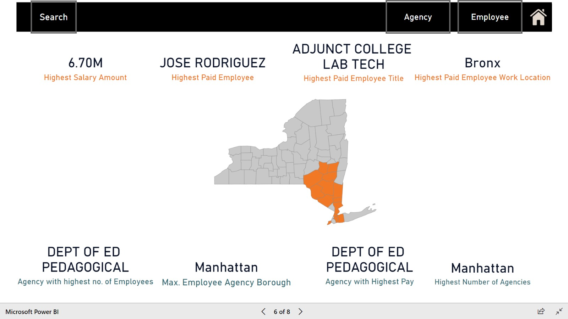
Visualization-Overview

Slide 15
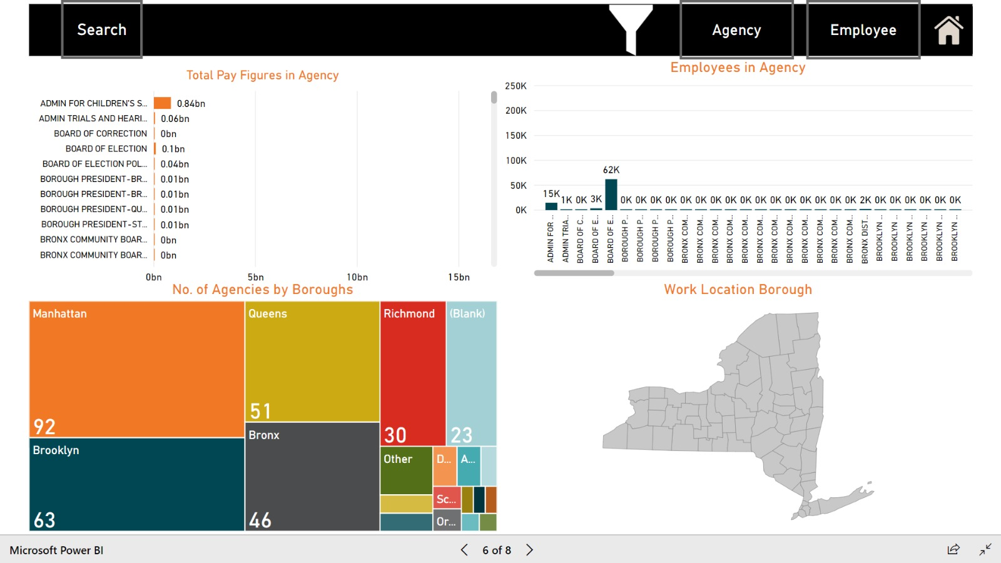
Visualization-Number of agencies vs. Pay Ratio

Slide 16
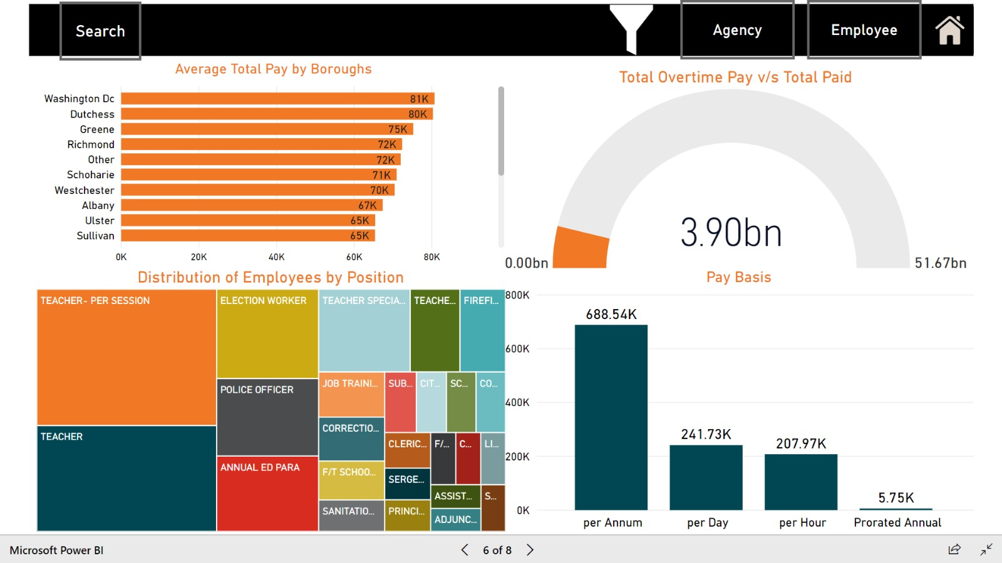
Visualization-The big overtime conundrum

Slide 17
Issues
MongoDB Atlas being a new tool where we had to learn for loading our data.
Excel sheet was difficult to use since our data size was more than 1,144,000 rows(1.9GB). So, we were not able to view the data in the first place.
Hence we chose MongoDB Atlas and through cloud cluster we loaded the data and through that other people could access and retrieve the data on the PowerBI tool.
Being on the cloud we could access it anywhere and we first tried the basic cluster in MongoDB Atlas which could only handle 500MB data , so we had to upgrade to 10GB cluster.
Implementation was initially done with m0-version which only takes for 500MB. There was no PowerBI configuration available which was one more reason we had to upgrade to m10 which has access of 10GB.
Since it was our first time connection a NoSQL Database to visualization, we had to understand the network settings/cloud configurations.
PowerBI issues - Integrating a new visualisation was a tedious process.

Slide 18
Data Principles
Understanding the data and its format.
Ensuring Data quality standards and regulations.
Reduced operational friction
Data ownership and accountabilities for cross-functional data-related decisions, processes, and controls.
Build standard, repeatable processes
Track the data changes made over a time period.
Transparency and documentation

Slide 19
References
https://www.mongodb.com/cloud/atlas
https://docs.mongodb.com/manual/tutorial/
https://powerbi.microsoft.com/en-us/
http://nosql-database.org

